Slide 1

Angular Spring Boot
Let them get married

Slide 2
Agenda
Need of coupled Deployments
Angular Deployment
Behaviour of <base>
Thymeleaf
Webjars
Angular + Maven
Configuration of WebMvcConfigurer
Configuration of WebFluxConfigurer
Spring Boot 3 changes
Reverse Proxy Configuration

Slide 3

About me
Age: 47
with adesso Austria since February 2023
married, 2 Children
passionate Nerd
Cooking, playing Computer Games, Backgammon
Clean-Code, Open Source, Java, Spring Boot, Angular, DevOp

Slide 4
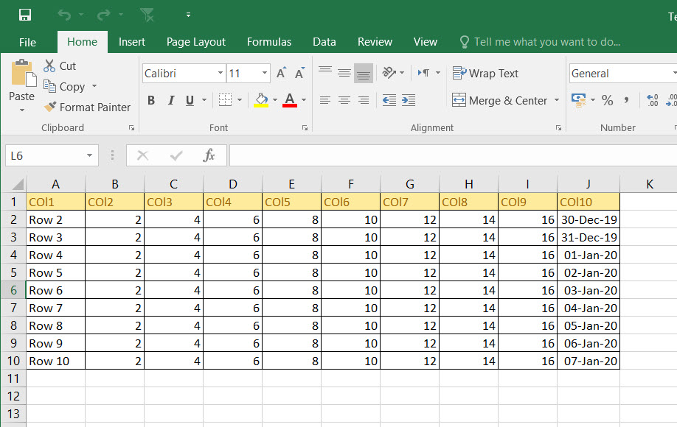

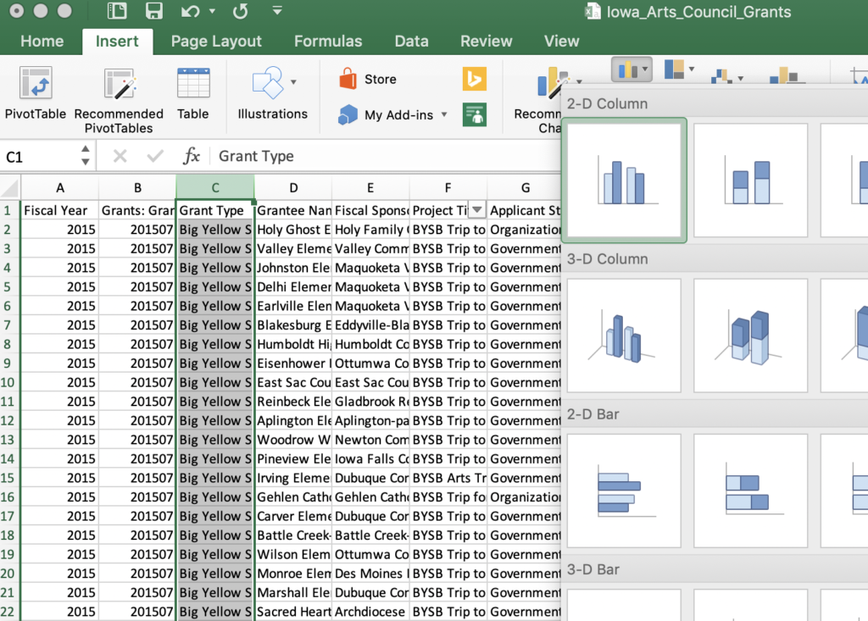
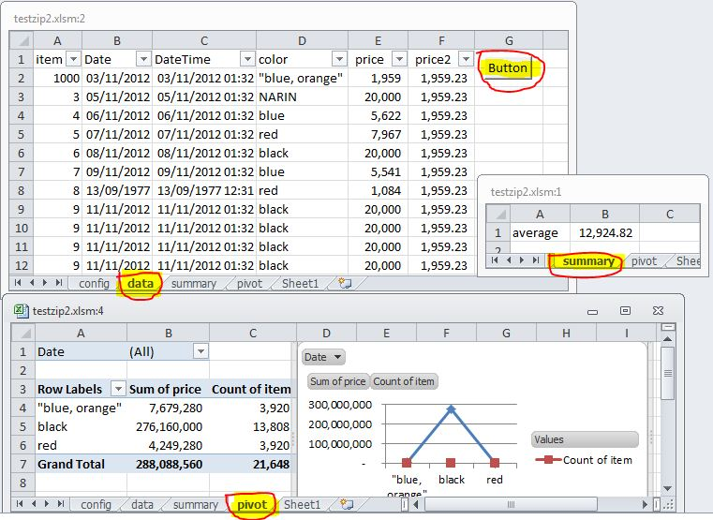
Need of coupled Deployments
many small Excel Files
shared across different Departments
different Versions of Excel Files
different Data within Excel Files
different Functionalities of shared Excel Files
common Solution:
many small Web-Applications
in the beginning small Requirements
Requirements tend to raise across Time and Budget

Slide 5
Prerequisites
Spring Boot 2.5+ (Example tested with Spring Boot 2.7)
Java 8
or
Spring Boot 3.0.2+
Java 17
Angular
any Version since Version 2
depends on the dist File Pattern
nodeJS and npm for local Development
Apache Maven 3.5+

Slide 6
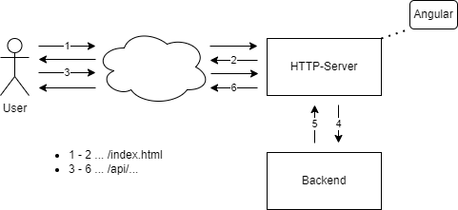
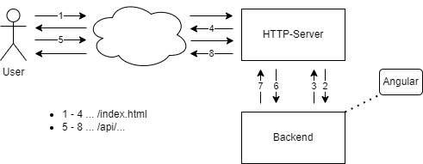
Angular Deployment

Slide 7
Angular Deployment
nginx
Apache
<VirtualHost *:80>
ServerName some.example.com
DocumentRoot “path/to/angular/files“
<Directory “path/to/angular/files“>
RewriteEngine On
RewriteCond %{REQUEST_FILENAME} !-f
RewriteCond %{REQUEST_FILENAME} !-d
RewriteRule ^ /index.html [L]
</Directory>
</VirtualHost>
server {
server_name some.example.com;
root /path/to/angular/files;
location / {
try_files $uri $uri/ /index.html;
}
}
Routed apps must fall back to index.html

Slide 8
Behaviour of <base>
without <base>
https://example.com/path/to/application/route/subroute
+ api/v1/some-path
https://example.com/path/to/application/route/subroute/api/v1/some-path
with <base href=“/path/to/application/“>
Caution of the trailing Slash – this is necessary !!!
https://example.com/path/to/application/route/subroute
+ api/v1/some-path
https://example.com/path/to/application/api/v1/some-path

Slide 9
Thymeleaf
https://thymeleaf.org
„Thymeleaf is a modern server-side Java template engine for both web and standalone environments“.
Idea: index.html of the Angular App as a Thymeleaf-Template
Advantages:
dynamic Resolution of <base href=“…“>
Include Fonts, Icons, … as a Webjar
Spring Boot Configuration
# Caution: the trailing / is needed by Thymeleaf
spring.thymeleaf.prefix=classpath:/META-INF/resources/frontend/

Slide 10
Webjars
https://webjars.org
„WebJars are client-side libraries (e.q. jQuery & Bootstrap) packaged into JAR (Java Archive) files.
Prefix: /META-INF/resources/webjars
Idea: include the Angular-App as a Webjar
Prefix: /META-INF/resources/frontend

Slide 11
Angular + Maven
change the Output-Path in angular.json
use frontend-maven-plugin
https://github.com/eirslett/frontend-maven-plugin
“architect“: {
“build“: {
“builder“: “@angular-devkit/build-angular:browser“,
“options“: {
“outputPath“: “target/classes/META-INF/resources/frontend“
}
}
}
<properties>
<maven.deploy.skip>true</maven.deploy.skip>
<node.version>v18.12.1</node.version>
<npm.version>9.1.2</npm.version>
</properties>
<plugin>
<groupId>com.github.eirslett</groupId>
<artifactId>frontend-maven-plugin</target>
…
</plugin>

Slide 12
Configuration of WebMvcConfigurer
Demo Time

Slide 13
Configuration of WebFluxConfigurer
Demo Time

Slide 14
Spring Boot 3 changes
native Images
include Files is possible but needs extra Work (index.html, favicon.ico, …)
changed Package Names
javax.validation → jakarta.validation
javax.annotation → jakarta.annotation
javax.* → jakarta.* ?
Bugs within WebMvcConfigurer / WebFluxConfigurer
Ticket #29712: ResourceHandlers cannot resolve static resources with .* wildcard pattern
solved with Spring Boot 3.0.2 → confirmed
Ticket #29739: ResourceHandlers cannot resolve static resources without wildcard patterns
solved by changed Implementation as described in Ticket
will be eventually fixed in Spring Framework 6.0.5

Slide 15
Reverse Proxy Configuration
Spring Boot Configuration
nginx.conf
server.forwarded-header-strategy=framework
location /path/to/angular/ {
proxy_pass http://application:8080/;
proxy_set_header Host $host;
proxy_set_header X-Real-IP $remote_addr;
proxy_set_header X-Forwarded-For $host;
proxy_set_header X-Forwarded-Proto $scheme;
proxy_set_header X-Forwarded-Port 8080;
proxy_set_header X-Forwarded-Prefix /path/to/angular;
}

Slide 16
Summary
Angular Deployment
Behaviour of <base>
Thymeleaf
Webjars
build Angular with Maven
WebMvcConfiguration
WebFluxConfiguration
Spring Boot 3 changes
Reverse Proxy Configuration

Slide 17



Example Code & Contact
Example Code:
https://github.com/mufasa1976/calcmaster
Runnable Example:
https://calcmaster.coolstuff.software
Contact
https://github.com/mufasa1976
https://www.linkedin.com/in/erich-stadler-6a6518199

Slide 18
Questions & Answers

Slide 19
And they lived happily ever after
Thank you for your Attention

